Slide 1
CAR PRICE PREDICTION
By :- Group – 03 Supervised By :- Vivek Prajapat Dr. Devlina Chatterjee Ashish Ubana Saurabh Kumar Gupta Pradnesh Lachake

Slide 2
Introduction of problem
A Chinese automobile company Geely Auto aspires to enter the US market by setting up their manufacturing unit there and producing cars locally to give competition to their US and European counterparts.
They have contracted an automobile consulting company to understand the factors on which the pricing of cars depends. Specifically, they want to understand the factors affecting the pricing of cars in the American market, since those may be very different from the Chinese market. The company wants to know:
Which variables are significant in predicting the price of a car
How well those variables describe the price of a car

Slide 3
Methodology :- We have used multi variate Linear Regression model. Using Recursive feature elimination (RFE) method, we have selected our attributes for the modelling on the basis of p-values and VIF (Variance Inflation Factor).

Slide 4
Description of Data
Source of Data :- UCI Machine Learning Repository
dataset :- https://archive.ics.uci.edu/ml/datasets/Automobile
Dependent Variable :- Price of car (Numeric)
Independent Variables :- There are a total of 25 independent variables.
Car_ID: Unique id of each observation (Interger)
Symboling: Its assigned insurance risk rating, A value of +3 indicates that the auto is risky, -3 that it is probably pretty safe.(Categorical)
carCompany: Name of car company (Categorical)
fueltype: Car fuel type i.e. gas or diesel (Categorical)
aspiration: Aspiration used in a car (Categorical)
doornumber: Number of doors in a car (Categorical)

Slide 5
Independent Variables :-
carbody: body of car (Categorical)
drivewheel: type of drive wheel (Categorical)
enginelocation: Location of car engine (Categorical)
wheelbase: Weelbase of car (Numeric)
carlength: Length of car (Numeric)
carwidth: Width of car (Numeric)
carheight: height of car (Numeric)
curbweight: The weight of a car without occupants or baggage. (Numeric)
enginetype: Type of engine. (Categorical)
cylindernumber: cylinder placed in the car (Categorical)
enginesize: Size of car (Numeric)
fuelsystem: Fuel system of car (Categorical)
boreratio: Boreratio of car (Numeric)

Slide 6
Independent Variables :-
stroke: Stroke or volume inside the engine (Numeric)
compressionratio: compression ratio of car (Numeric)
horsepower: Horsepower (Numeric)
peakrpm: car peak rpm (Numeric)
citympg: Mileage in city (Numeric)
highwaympg: Mileage on highway (Numeric)

Slide 7
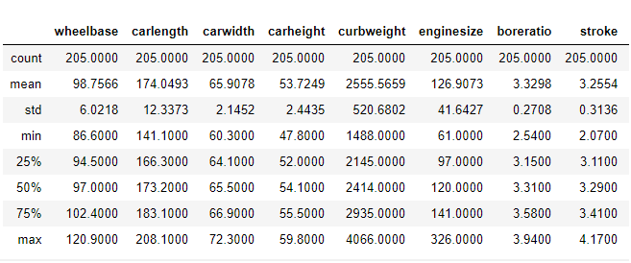
Description of Data

Slide 8
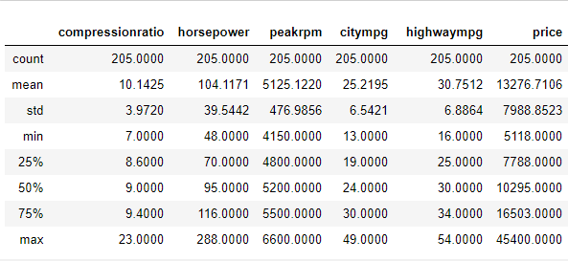
Description of Data
There is a large variation in the given variables by looking at the data description. so, we will normalize the data by Z score normalization.

Slide 9
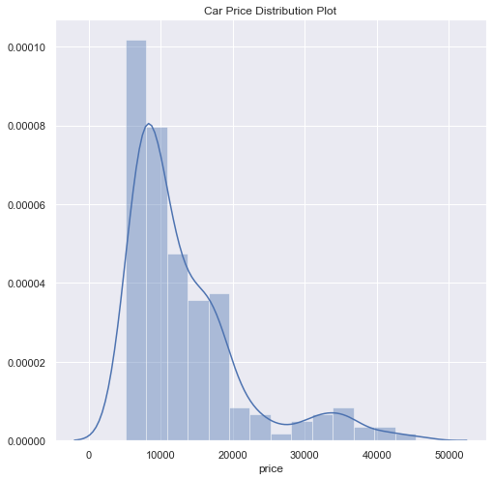
Car Price Distribution Plot
Car Price Distribution plot is positively skewed.
mean 13276.710571
std 7988.852332
min 5118.000000
25% 7788.000000
50% 10295.000000
75% 16503.000000
max 45400.000000

Slide 10
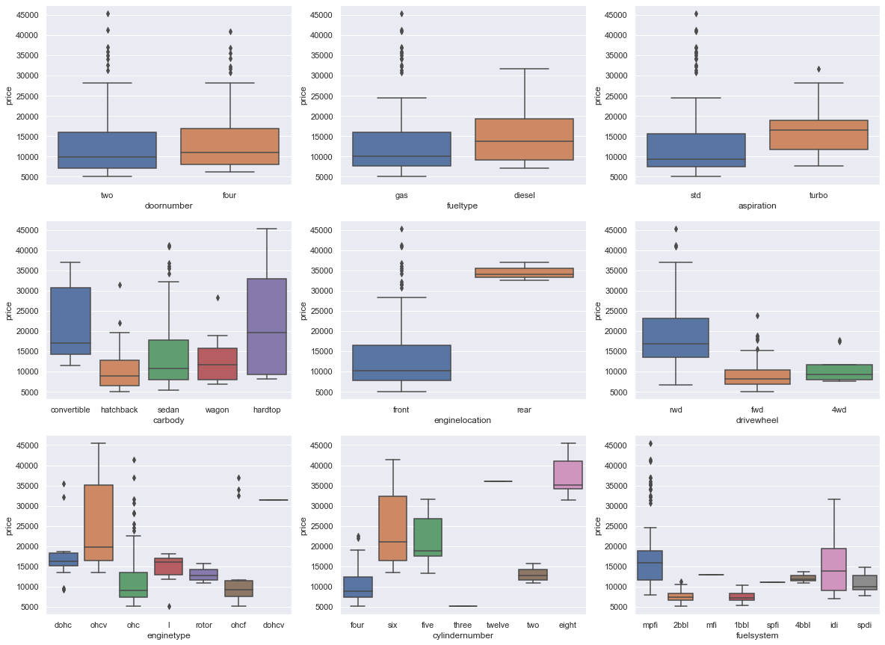
Door Number isn't affecting the price much.
The cars with fuel type as diesel are comparatively expensive than the cars with fuel type as gas.
Turbo charge cars relatively expansive than standard cars.
All the types of car body is relatively cheaper as compared to convertible car body.
The cars with rear engine location are way expensive than cars with front engine location.
Higher End cars seems to have rwd drive wheel.
Engine type ohcv comes into higher price range cars.
The price of car is directly proportional to no. of cylinders in most cases.

Slide 11
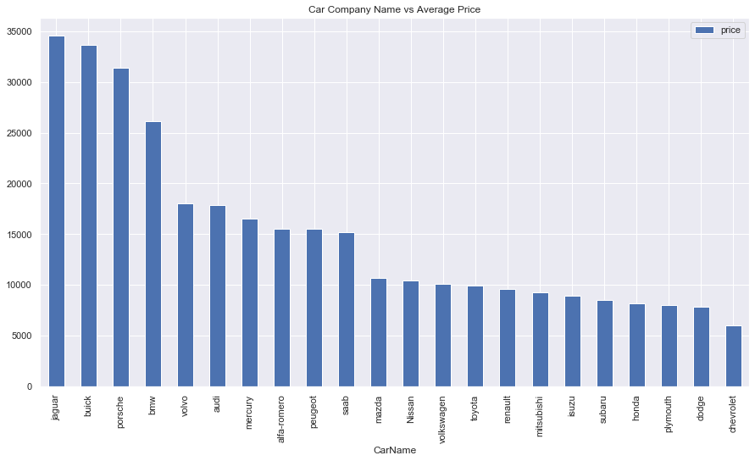
Based on average prices Jaguar, Buick and Porsche seems to have the highest average price.

Slide 12
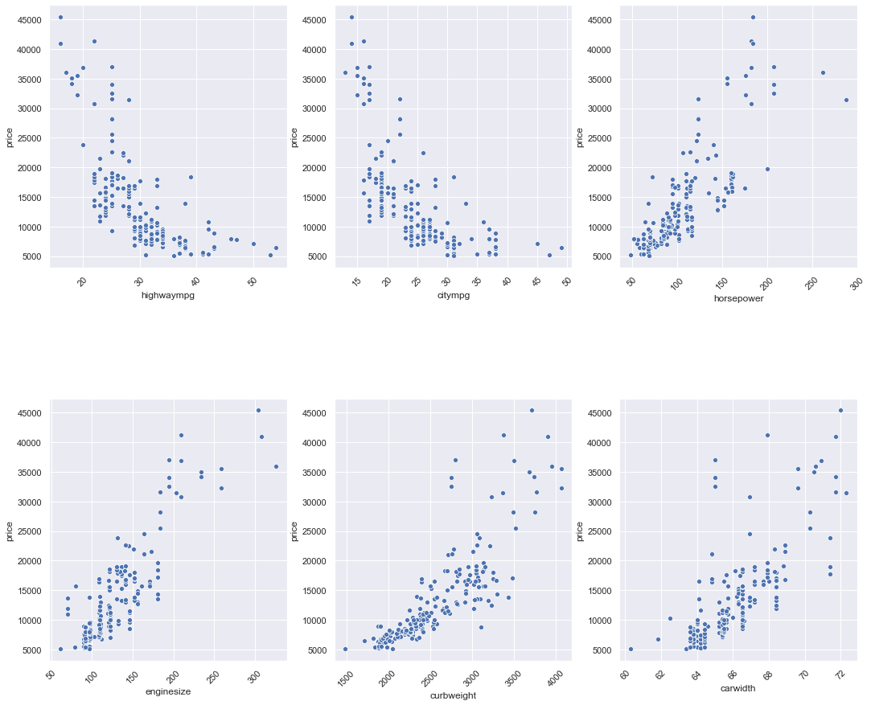
Scatter Plot
Based on the scatter plot of the horsepower, enginesize, curbweight, carwidth shows a positive correlation.
Highwaympg, citympg shows a negative correlation with the car price.

Slide 13
Linear Regression Model using Forward Selection of Features
We have started building our model with a single regressor with Independent variable,
‘horsepower’ being highly correlated with the dependent variable ‘car price’.
Model 1:
const 0.0000
Horsepower 0.8062
After building the model the R^2 value obtained is 0.65. In order to better explain the dependent variable we included some new independent variables in our model. These independent variables will be selected based on their correlation values with the price.
The second highly correlated variable, ‘curbweight’ is introduced in the model 2. Model 2:
const 0.0000
horsepower 0.3581
curbweight 0.5898
The R^2 value for model 2 is 0.797.

Slide 14
Linear Regression Model using Forward Selection of Features
To further explain our dependent variable, we will add another highly correlated variable, ‘enginesize’.
Model 3:
const 0.0000
horsepower 0.2288
curbweight 0.3938
enginesize 0.3400
In model 3, we included horsepower, curbweight, enginesize and found R^2 to be 0.819.

Slide 15
Using just only top three highly correlated variables, we have been able to explain around 82% of the dependent variable.
But, there are 22 independent variables which have not been used to explain the dependent variable.
So, here we have a problem of omitted variable bias (OVB) in the model.
The OVB can be eliminated by introducing more independent variables to our model.
There are two approaches, either we could use forward selection or backward elimination method to build our model.
Since we have a lot of variables forward selection method is not a better choice. We have decided to build our model using Recursive Feature Elimination (RFE) method.

Slide 16
The Car_ID, independent variable, has been dropped based on business knowledge. Since it is unique for every car and it has no effect on the car price. We will include every independent variable and then on the basis of the below criterion:
We will drop the variable with high p-value and high VIF
We will drop the variable with highest p-value between variables with high p-value low VIF or low p-value high VIF
We will retain the variable with low p-value and low VIF

Slide 17
Models using RFE method:
Under this model we will be iteratively drop the independent variables whose p-value is greater than 0.05 (i.e. 95 percent of confidence). Then we will drop those variables whose VIF value is greater than 5.
Initial stage:
R^2 = 0.936
Adj R^2 = 0.929
Dropping cylindernumber_twelve having p-value 0.393.
Model 1:
R^2 = 0.936
Adj R^2 = 0.929
Dropping cylindernumber_six having p-value 0.493.
Model 2:
R^2 = 0.936
Adj R^2 = 0.929
Dropping carbody_hardtop having p-value 0.238.

Slide 18
Model 3:
R^2 = 0.935
Adj R^2 = 0.929
Dropping enginetype_ohc having p-value 0.110.
Model 4:
R^2 = 0.934
Adj R^2 = 0.928
Dropping cylindernumber_five having p-value 0.104.
Model 5:
R^2 = 0.932
Adj R^2 = 0.927
Dropping enginetype_ohcv having p-value 0.180.

Slide 19
Model 6:
R^2 = 0.931
Adj R^2 = 0.927
Dropping enginetype_ohcv having p-value 0.180.
Model 7:
R^2 = 0.931
Adj R^2 = 0.927
Dropping curbweight having VIF 8.1.
Model 8:
R^2 = 0.924
Adj R^2 = 0.919
Dropping cylindernumber_four having VIF 5.66.

Slide 20
Model 9:
R^2 = 0.918
Adj R^2 = 0.914
Dropping carbody_sedan by preliminary data visualisation and checking if there is substantial drop in R^2 value. The goal is to explain maximum variance with minimum variable.
Model 10:
R^2 = 0.913
Adj R^2 = 0.909
After dropping the variable carbody_sedan, there is no substantial drop in R^2 value. So, we will proceed with dropping carbody_sedan.
Dropping carbody_wagon having p-value 0.315.
Model 11:
R^2 = 0.912
Adj R^2 = 0.909
Dropping carbody_wagon having p-value 0.315.

Slide 21
 | Model - 1 |  |  | Model - 2 |  |  | Model - 3
Variable | Beta Value | p Values | VIF Values | Beta Value2 | p Values3 | VIF Values4 | Beta Value5 | p Values6 | VIF Values7
const | 0.7074 | 0 |  | 0.7124 | 0 |  | 0.6736 | 0
curbweight | 0.247 | 0 | 9.06 | 0.248 | 0 | 9.06 | 0.2384 | 0 | 8.53
horsepower | 0.215 | 0 | 5.61 | 0.2324 | 0 | 4.69 | 0.2273 | 0 | 4.53
carwidth | 0.227 | 0 | 6.24 | 0.2328 | 0 | 6.15 | 0.2408 | 0 | 5.72
Cars_Category_TopNotch_Cars | 1.061 | 0 | 2.17 | 1.0502 | 0 | 2.14 | 1.0599 | 0 | 2.13
carbody_hardtop | -0.2211 | 0.303 | 1.45 | -0.2314 | 0.279 | 1.45 | -0.25 | 0.238 | 1.28
carbody_hatchback | -0.6016 | 0 | 6.15 | -0.6198 | 0 | 5.95 | -0.6311 | 0 | 3.76
carbody_sedan | -0.4691 | 0.002 | 9.73 | -0.4951 | 0.001 | 9.05 | -0.5123 | 0.001 | 5.24
carbody_wagon | -0.5865 | 0 | 3.48 | -0.6111 | 0 | 3.31 | -0.6269 | 0 | 2.36
enginetype_dohcv | -1.0254 | 0.006 | 1.84 | -0.9329 | 0.008 | 1.67 | -0.8773 | 0.01 | 1.6
enginetype_ohc | 0.126 | 0.061 | 5.97 | 0.1212 | 0.07 | 5.92 | -0.1104 | 0.088 | 5.65
enginetype_ohcv | -0.1968 | 0.105 | 1.63 | -0.2225 | 0.059 | 1.53 | -0.218 | 0.063 | 1.52
cylindernumber_five | -0.3815 | 0.022 | 2.82 | -0.3529 | 0.03 | 2.66 | -0.2894 | 0.03 | 1.97
cylindernumber_four | -0.4642 | 0 | 15.92 | -0.4483 | 0.001 | 15.27 | -0.3896 | 0 | 8.99
cylindernumber_six | -0.1381 | 0.322 | 4.73 | -0.0857 | 0.493 | 3.7
cylindernumber_twelve | -0.296 | 0.393 | 1.66

Slide 22
 | Model - 4 |  |  | Model - 5 |  |  | Model - 6
Variable | Beta Value8 | p Values9 | VIF Values10 | Beta Value11 | p Values12 | VIF Values13 | Beta Value14 | p Values15 | VIF Values16
const | 0.5631 | 0 |  | 0.5665 | 0 |  | 0.4821 | 0
curbweight | 0.2474 | 0 | 8.51 | 0.2288 | 0.001 | 8.25 | 0.246 | 0 | 8.1
horsepower | 0.2179 | 0 | 4.17 | 0.2151 | 0 | 4.17 | 0.2289 | 0 | 4.13
carwidth | 0.2386 | 0 | 5.65 | 0.2397 | 0 | 5.65 | 0.2058 | 0 | 5.08
Cars_Category_TopNotch_Cars | 1.0606 | 0 | 2.08 | 1.1121 | 0 | 1.83 | 1.1276 | 0 | 1.83
carbody_hardtop
carbody_hatchback | -0.5214 | 0 | 3.31 | -0.4954 | 0 | 3.1 | -0.4798 | 0 | 2.63
carbody_sedan | -0.4054 | 0 | 4.64 | -0.3789 | 0.001 | 4.33 | -0.3696 | 0.001 | 3.52
carbody_wagon | -0.5259 | 0 | 2.22 | -0.5137 | 0 | 2.2 | -0.5091 | 0 | 1.94
enginetype_dohcv | -0.8407 | 0.014 | 1.58 | -0.883 | 0.01 | 1.57 | -0.8214 | 0.016 | 1.54
enginetype_ohc | 0.1029 | 0.11 | 5.6
enginetype_ohcv | -0.1975 | 0.089 | 1.52 | -0.2098 | 0.072 | 1.51 | -0.1484 | 0.18 | 1.43
cylindernumber_five | -0.2793 | 0.036 | 1.93 | -0.2024 | 0.104 | 1.63
cylindernumber_four | -0.3811 | 0 | 8.09 | -0.3351 | 0 | 6.8 | -0.2608 | 0.001 | 5.76
cylindernumber_six
cylindernumber_twelve

Slide 23
 | Model - 7 |  |  | Model - 8 |  |  | Model - 9
Variable | Beta Value17 | p Values18 | VIF Values19 | Beta Value20 | p Values21 | VIF Values22 | Beta Value23 | p Values24 | VIF Values25
const | 0.4472 | 0.001 |  | 0.4709 | 0.001 |  | 0.244 | 0.038
curbweight | 0.2449 | 0 | 8.1
horsepower | 0.2146 | 0 | 3.81 | 0.3021 | 0 | 2.72 | 0.3599 | 0 | 2.44
carwidth | 0.206 | 0 | 5.08 | 0.3523 | 0 | 2.22 | 0.3652 | 0 | 2.12
Cars_Category_TopNotch_Cars | 1.1456 | 0 | 1.81 | 1.2141 | 0 | 1.73 | 1.2895 | 0 | 1.7
carbody_hardtop
carbody_hatchback | -0.4744 | 0 | 2.47 | -0.5316 | 0 | 2.4 | -0.4859 | 0 | 1.1
carbody_sedan | -0.3619 | 0.002 | 3.35 | -0.3839 | 0.001 | 3.35 | -0.3518 | 0.004 | 1.22
carbody_wagon | -0.5038 | 0 | 1.89 | -0.423 | 0.002 | 1.71 | -0.4023 | 0.003 | 1.02
enginetype_dohcv | -0.7421 | 0.028 | 1.49 | -1.2424 | 0 | 1.24 | -1.445 | 0 | 1.22
enginetype_ohc
enginetype_ohcv
cylindernumber_five
cylindernumber_four | -0.2382 | 0.002 | 5.66 | -0.2504 | 0.002 | 5.66
cylindernumber_six
cylindernumber_twelve

Slide 24
Variable | Beta Value26 | p Values27 | VIF Values28 | Beta Value29 | p Values30 | VIF Values31
const | -0.0748 | 0.057 |  | -0.0925 | 0.009
curbweight
horsepower | 0.3837 | 0 | 2.31 | 0.3847 | 0 | 2.28
carwidth | 0.339 | 0 | 2.08 | 0.3381 | 0 | 2.07
Cars_Category_TopNotch_Cars | 1.3063 | 0 | 1.46 | 1.3179 | 0 | 1.45
carbody_hardtop
carbody_hatchback | -0.1738 | 0.004 | 1.1 | -0.1565 | 0.006 | 1.1
carbody_sedan
carbody_wagon | -0.0792 | 0.315 | 1.02
enginetype_dohcv | -1.4904 | 0 | 1.22 | -1.5033 | 0 | 1.22
enginetype_ohc
enginetype_ohcv
cylindernumber_five
cylindernumber_four
cylindernumber_six
cylindernumber_twelve

